Slide 1
Self-Organizing Map (SOM)
Unsupervised Learning Technique
Also called Kohonen Map

Slide 2
Introduction
SOM maps high-dimensional data to 2D grid
Preserves topology
Used for clustering and visualization

Slide 3
Structure
Grid of neurons
Each neuron has weight vector
Same dimension as input

Slide 4
Algorithm Steps
1. Initialize weights
2. Find BMU
3. Update weights
4. Repeat

Slide 5
Best Matching Unit (BMU)
Neuron with minimum distance to input
Usually Euclidean distance

Slide 6
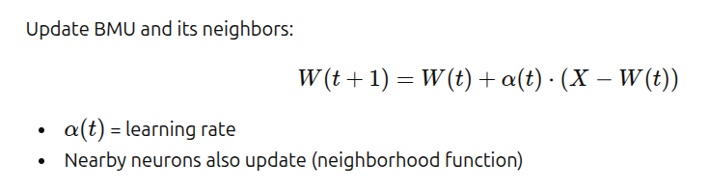
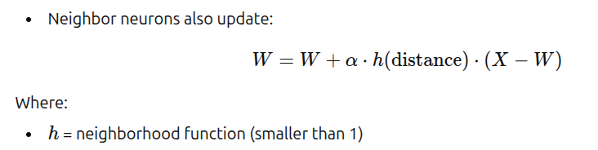
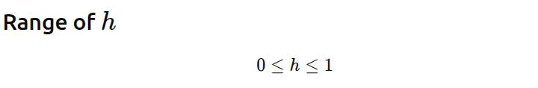
Weight update without neighbor
Weight update with neighbor

Slide 7
Neighborhood Function
Neighbors also updated
h = e^(-d^2)
Closer neurons updated more
Learning Rate Decay
α(t) = α0 * e^(-t)
Decreases over time

Slide 8
Grid Distance
Distance between neurons on map
Used for neighborhood function

Slide 9
Stopping Criteria
Max iterations
Weights stabilize
Learning rate small

Slide 10
Example
Input Data
X1=[0.2,0.3,0.4], X2=[0.25,0.35,0.45], X3=[0.7,0.8,0.9]
Initial weights
W1=[0.2,0.4,0.5], W2=[0.9,0.5,0.4]

Slide 11
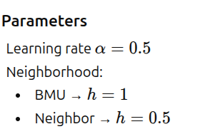

Slide 12
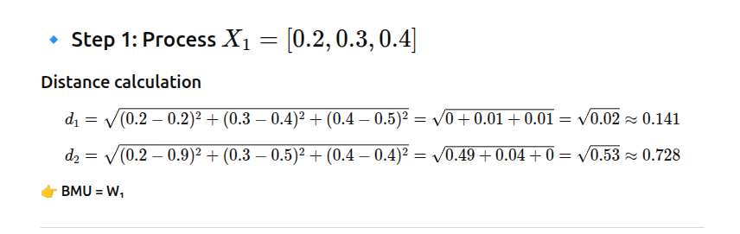
Iteration 1
BMU = N1 [Neuron1(N1) represents the output unit and it represents a cluster(group of inputs)]

Slide 13
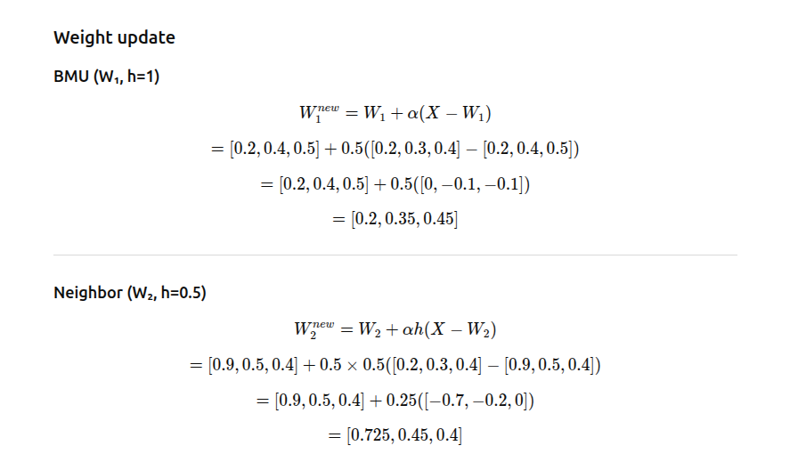

Slide 14
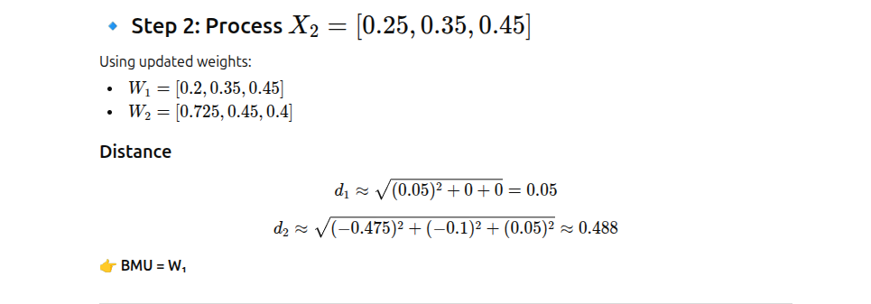
BMU= N1

Slide 15
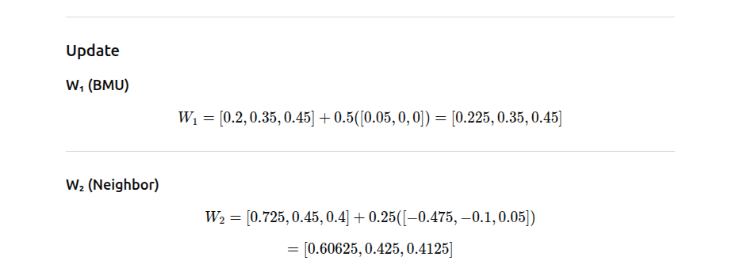

Slide 16
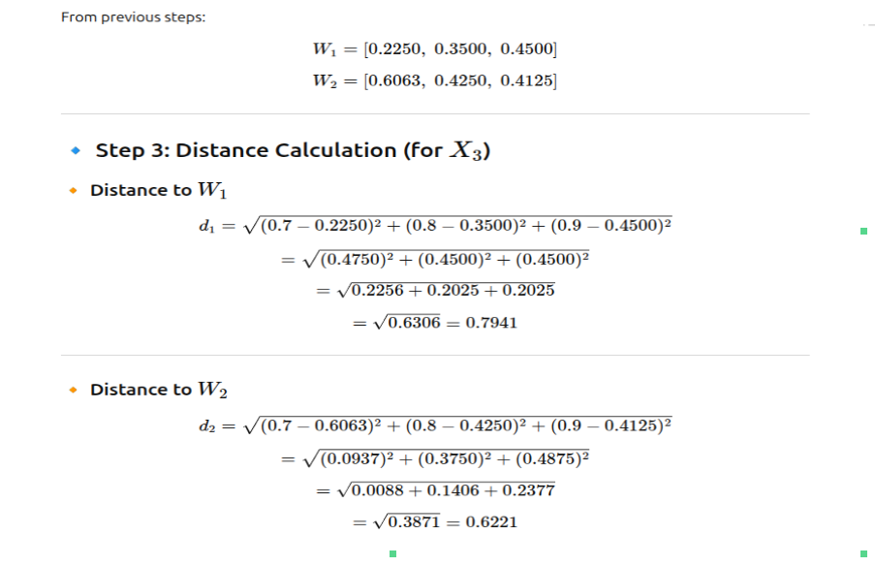
X3=[0.7,0.8,0.9]
BMU= N2

Slide 17
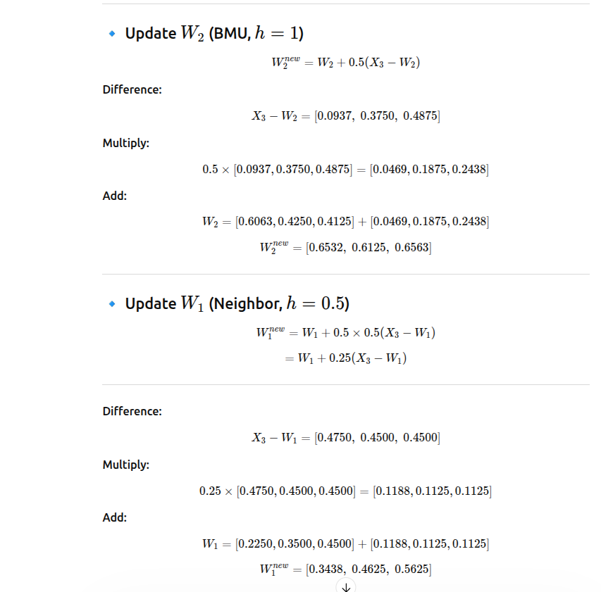

Slide 18
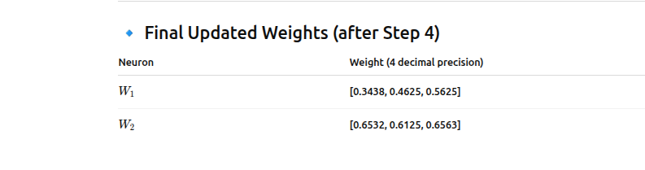

Slide 19
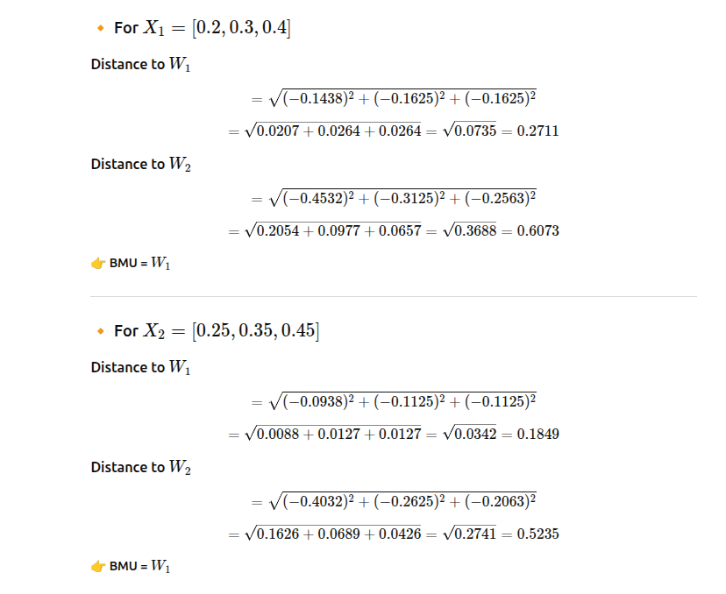
From final weights, for every input, find the distance

Slide 20
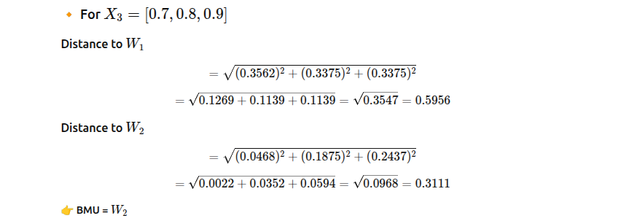

Slide 21
Final Clusters
Cluster 1 → N1 → X1, X2
Cluster 2 → N2 → X3

Slide 22
Advantages
No labeled data
Topology preserved
Good visualization

Slide 23
Disadvantages
Computational cost
Grid size selection
Not precise clustering

Slide 24
Applications
Clustering
Image compression
Pattern recognition
Customer segmentation

